Slide 1

INTRODUCTION TO MECHANICS

Slide 2
DEFINITION OF MECHANICS
Mechanics may be defined as the physical science which describes and predicts the conditions of rest or motion of bodies under the action of force systems.
MECHANICS
NEWTONIAN
MECHANICS
RELATIVISTIC
MECHANICS
QUANTUM
MECHANICS
In other words, where there is motion or force, there is mechanics.

Slide 3
NEWTONIAN MECHANICS: In engineering, mechanics is generally based on Newton’s Laws and is often called Newtonian (or Classical) Mechanics after the English scientist Sir Isaac Newton (1642-1727). RELATIVISTIC MECHANICS :Conditions involving speed of bodies close to the speed of light (about 300 x 106 m/s) and conditions requiring consideration of bodies with extremely small mass QUANTUM MECHANICS: Size (such as subatomic particles with sizes in the order of 10-12 m and smaller) cannot be adequately described by Newton’s Laws.

Slide 4
Mechanics is divided into three parts as shown below:
Mechanics
Mechs. of Rigid Bodies
Statics
Dynamics
Mechs. of Fluids
Incompressible Fluids
Mechs. of Deformable Bodies
Theory of Elasticity
Theory of Plasticity
Theory of Failure
Compressible Fluids

Slide 5
Mechanics of rigid bodies is divided into two parts as “Statics” and “Dynamics”.
Statics, is the branch of mechanics that deals with the bodies that are acted on by balanced forces
A force system acting on a body is said to be balanced if it has no tendency to change the state of rest or motion of the body in any way. If a body is in equilibrium, the force system acting on it must be balanced.
Dynamics is concerned with moving bodies. It is subdivided into two parts as Kinematics and Kinetics.
Kinematics deals with the geometry of motion without taking into consideration the loading that causes this motion.
Kinetics considers the loads that cause the motion.

Slide 6
FUNDAMENTAL CONCEPTS
The basic concepts in mechanics are space, time, mass and force.
In Newtonian mechanics, space, time and mass are absolute quantities, which mean that they are independent of each other
Space: is the geometric region occupied by bodies whose positions are described by linear or angular measurements relative to a specific coordinate system.
Time: is a concept for measuring the succession and the duration of events. Time is not directly involved in the analysis of problems in Statics.
Mass: is a measure of the translational inertia of the body, which is its resistance to a change in velocity. Mass can also be thought of as the quantity of matter in a body.
Force: A force represents the action of one body on another. Force can be generated either by the direct contact of bodies or by their effect at a distance. Forces always occur in pairs. Forces of a pair are always equal in magnitude and opposite in direction. Force is a vector quantity. The action of a force is characterized by its magnitude, by the direction of its action and by its point of application.

Slide 7
IDEALIZATION IN MECHANICS
Particle:is a body of negligible dimensions. In the mathematical sense, a particle is a body whose dimensions are considered to be near zero so that we may analyze it as a mass concentrated at a point. A particle has mass but no shape and dimensions.
Rigid Body: is an idealized body composed of a large number of particles all of which always remain at fixed distances from each other. A rigid body is assumed to undergo no deformation under the action of applied forces.
Point Force: is an idealized force assumed to act at a point on a body. A constant force exerted on a body by another is actually distributed over the area of contact between two bodies.

Slide 8
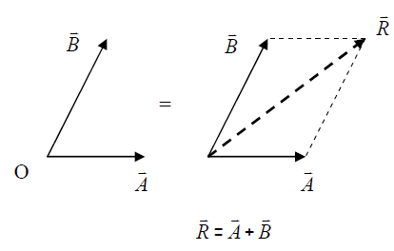
LAWS OF MECHANICS
_ _ _
The Parallelogram Law: Two vectors A and B , treated as free vectors, can be replaced by their equivalent R ,which
_ _
is the diagonal of the parallelogram formed by A and B as its two sides, as shown.
_ _ _ _ _
R is called the resultant of A and B. Hence, the combined effect of two forces A and B

Slide 9
2) The Principle of Transmissibility: The effect of a force on a rigid body will remain unchanged if the forced is moved to act on its line of action. In other words, a force may be applied at any point on its given line of action without altering the resultant effects on the rigid body on which it acts.
3) Newton’s First Law: If the resultant force acting on a particle is zero, then the particle is in equilibrium. Stated mathematically as (Σ F = 0 ), where F is the vector sum (the resultant) of all the forces acting on the particle.
4) Newton’s Second Law: The acceleration of a particle is proportional to the resultant force acting on it and is in the direction of this force.
5) Newton’s Third Law: The forces of action and reaction between interacting bodies are equal in magnitude, opposite in direction and collinear.

Slide 10
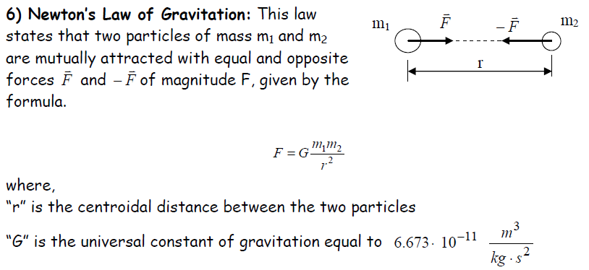

Slide 11
Triangle Law of Vectors
The Triangle Law of Forces (vectors) may be stated as if two forces (vectors) acting on a body are represented one after another by the sides of a triangle, their resultant is represented by the closing side of the triangle taken from the first point to the last point.
Polygon Law of Forces (Vectors)
If a number of concurrent forces (vectors) acting simultaneously on a body are represented in magnitude and direction by the sides of a polygon, taken in a order, then the resultant is represented in magnitude and direction by the closing side of the polygon, taken from the first point to the last point.

Slide 12
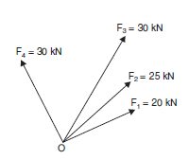
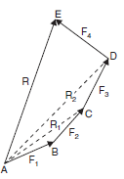
A system of four concurrent forces acting on a body are shown in Fig. . AB represents F1 and BC represent F2. Hence according to triangle law of forces AC represents the resultant of F1 and F2, say R1.
If CD is drawn to represent F3, then from the triangle law of forces AD represents the resultant of R1 and F3. In other words, AD represents the resultant of F1, F2 and F3. Let it be called as R2.

Slide 13
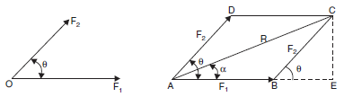
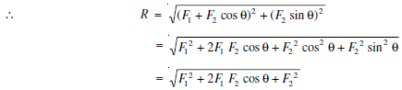
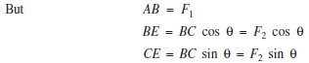
Consider the two forces F1 and F2 acting on a particle as shown in Fig . Let the angle between the two forces be θ. If parallelogram ABCD is drawn as shown in Fig. with AB respresenting F1 and AD representing F2 to some scale, according to parallelogram law of forces AC represents the resultant R. Drop perpendicular CE to AB.
The resultant R of F1 and F2 is given by

Slide 14
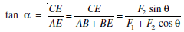
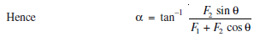
The inclination of resultant to the direction of F1 is given by α, where

Slide 15
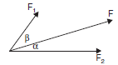
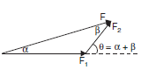
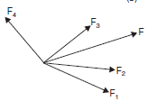
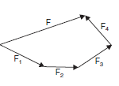
Resolution of Vectors
Since the resolution of vectors is exactly opposite process of composition of vectors, exactly the opposite process of composition can be employed to get the resolved components of a given force.
In Fig. the given force F is resolved into two components making angles α and β with F.
In Fig. the force F is resolved into its four components F1, F2, F3 and F4.

Slide 16
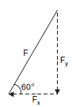
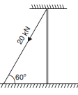
Example. 1.2. The guy wire of the electrical pole shown in Fig. makes 60° to the horizontal and is carrying a force of 20 kN. Find the horizontal and vertical components of the force.
Solution: Figure shows the resolution of force F = 20 kN into its components in horizontal and vertical components. From the figure it is clear that
Fx = F cos 60° = 20 cos 60° = 10 kN (to the left)
Fy = F sin 60° = 20 sin 60° = 17.32 kN (downward)

Slide 17
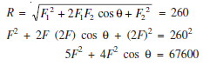
Example 1. The resultant of two forces, one of which is double the other is 260 N. If the direction of the larger force is reversed and the other remain unaltered, the magnitude of the resultant reduces to 180 N. Determine the magnitude of the forces and the angle between the forces.
Solution: Let the magnitude of the smaller force be F. Hence the magnitude of the larger force is 2F.
Thus F1 = F and F2 = 2F
Let θ be the angle between the two forces.
From the condition 1, we get

Slide 18
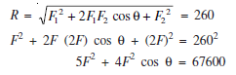
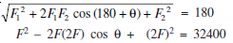
Example The resultant of two forces, one of which is double the other is 260 N. If the direction of the larger force is reversed and the other remain unaltered, the magnitude of the resultant reduces to 180 N. Determine the magnitude of the forces and the angle between the forces.
Solution: Let the magnitude of the smaller force be F. Hence the magnitude of the larger force is 2F.
Thus F1 = F and F2 = 2F
Let θ be the angle between the two forces.
From the condition 1, we get
From condition 2, we get

Slide 19
Adding equation
10F2 = 100000
∴ F = 100 N
Hence F1 = F = 100 N; F2 = 2F = 200 N
Substituting the values of F1 and F2 in eqn (i), we get,
5(100)2 + 4(100)2 cos θ = 67600
∴ cos θ = 0.44
or θ = 63.9°

Slide 20
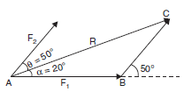
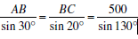
Example. Two forces F1 and F2 are acting at point A as shown in Fig. The angle between the two forces is 50°.It is found that the resultant R is 500 N and makes angles 20° with the force F1 as shown in the figure. Determine the forces F1 and F2.
Solution: Let Δ ABC be the triangle of forces drawn to some scale. In this
∠BAC = α = 20°
∠ABC = 180 – 50 = 130°
∴ ∠ACB = 180 – (20 + 130) = 30°
Applying sine rule to Δ ABC, we get
AB = 326.35 N
and BC = 223.24 N.
Thus F1 = AB = 326.35 N
and F2 = BC = 223.24 N

Slide 21
Problem 1. The resultant of two forces F1 = 400 N and F2 = 260 N acting at point A is 520 N. Determine the angle between the two forces and the angle between the resultant and force F1.
Problem 2. The resultant of two forces one of which is 3 times the other is 300 N. When the direction of smaller force is reversed, the resultant is 200 N. Determine the two forces and the angle between them.

Slide 22
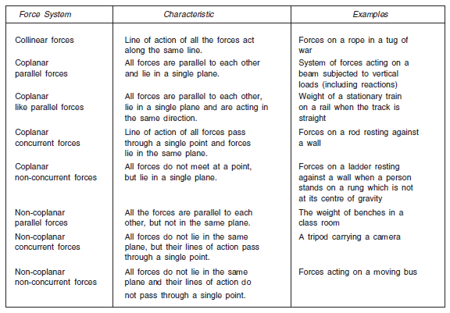
Principles of Superposition of Forces
It states that the net effect of a system of forces on a body is same as the combined of individual forces acting on the body.
SYSTEM OF FORCES

Slide 23
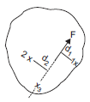
MOMENT OF A FORCE
Moment of a force about a point is the measure of its rotational effect.
Moment is defined as the product of the magnitude of the force and the perpendicular distance of the point from the line of action of the forces.
The point about which the moment is considered is called moment centre and the perpendicular distance of the point from the line of action of the force is called moment arm.
If d1 is the perpendicular distance of point 1 from the line of action of force F, the moment of F about point 1 is given by
Similarly, moment about point 2 is given by
M2 = F d2
If the moment centre 3 lies on the line of action of the force F, the moment arm is zero and hence,
M3 = F × 0 = 0
The moment of a force has got direction also. In Fig. it may be noted that M1 is clockwise and M2 is anticlockwise

Slide 24
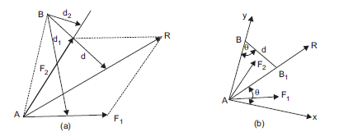
VARIGNON’S THEOREM
The algebraic sum of the moments of a system of coplanar forces about a moment centre in their plane is equal to the moment of their resultant force about the same moment centre.
Rd = F1 d1 + F2 d2

Slide 25
COUPLE
Two parallel forces equal in magnitude and opposite in direction and separated by a definite distance are said to form a couple. The sum of the forces forming a couple is zero, since they are equal and opposite, which means the translatory effect of the couple is zero.
The sum of the forces forming a couple is zero, since they are equal and opposite, which means the translatory effect of the couple is zero.

Slide 26
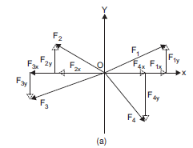
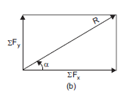
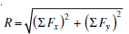
COMPOSITION OF CONCURRENT COPLANAR FORCES
Let F1, F2, F3 and F4 shown in Fig. be the system of four forces the resultant of which is required.
The procedure to get the resultant is given below:
Step 1: Find the components of all the forces in X and Y directions. Thus, F1x, F2x, F3x, F4x, F1y, F2y, F3y, and F4y, are obtained.
Step 2: Find the algebraic sum of the component forces in X and Y directions.
ΣFx = F1x + F2x + F3x + F4x
ΣFy = F1y + F2y + F3y + F4y
(Note: In the above case F2x, F3x, F3Y and F4Y have negative values.)
Step 3: Now the system of forces is equal to two mutually perpendicular forces, namely, ΣFx and ΣFy as shown in Fig. (b). Since these two forces are perpendicular, the parallelogram of forces becomes a rectangle. Hence the resultant R is given by:

Slide 27
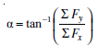
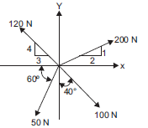
and its inclination to x axis is given by:
Example . A system of four forces acting on a body is as shown in Fig. Determine the resultant.

Slide 28
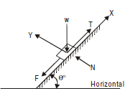
Example 2.5. A system of forces acting on a body resting on an inclined plane is as shown in Fig.. Determine the resultant force if θ= 60° and if W = 1000 N; N = 500 N; F = 100 N; and T = 1200 N.

Slide 29
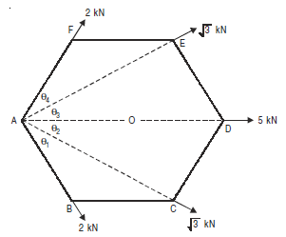
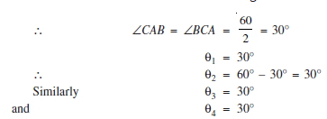
Example. Forces 2, √3, 5, √3 and 2 kN respectively act at one of the angular points of a regular hexagon towards five other angular points. Determine the magnitude and direction of the resultant force.
Solution: Let the system of forces be as shown in Fig. shown below:
Let O be the centre of the encircling circle A, B, C, D, E and F. In regular hexagon each side is equal to the radius AO. Hence OAB is equilateral triangle.
OAB = 60°
In Δ ABC, BA = BC
∴ ∟ CAB = ∟ BCA
But ∟CAB + ∟ BCA = interior angle at B
= 180° – 120° = 60°

Slide 30
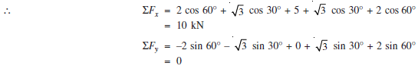
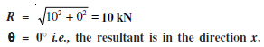

Slide 31
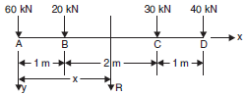
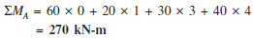
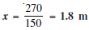
Example Determine the resultant of four parallel forces acting on the axle of a vehicle as shown in Fig.
Solution: Let x and y axes be selected as shown in the Figure
Rx = ΣFx = 0
Ry = Σ Fy = 60 + 20 + 30 + 40 = 150 kN
Taking clockwise moment as +ve,

Slide 32
TYPES OF FORCES ON A BODY
The various forces acting on a body may be grouped into:
Applied Forces
(b) Non-applied Forces
(a) Applied Forces
These are the forces applied externally to a body. Each of the forces is having contact with the body.
Depending upon type of their contact with the body, the applied forces may be classified as:
(i) Point Force (ii) Distributed Forces
(i) Point Force: It is the one which has got contact with the body at a point. Practically there is no force which will have contact with the body at a single point. However, when the contact area is small compared to the other dimensions in the problem, for simplicity of calculation the force may be considered as a point load.
(ii) Distributed Forces: Distributed forces may act over a line, a surface or a volume. Correspondingly they are known as linear, surface and body forces.

Slide 33
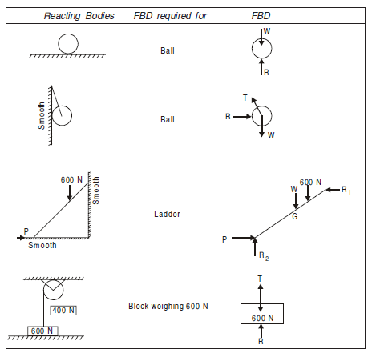
FREE BODY DIAGRAM
Such a diagram of the body in which the body under consideration is freed from all the contact surfaces and shows all the forces acting on it (including reactions at contact surfaces), is called a Free Body Diagram (FBD).
Free Body Diagrams (FBD) are shown for few typical cases in

Slide 34
EQUILIBRIUM OF BODIES
A body is said to be in equilibrium when it is at rest or has uniform motion.
According to Newton’s law of motion, it means the resultant of all the forces acting on a body in equilibrium is zero.
The resultant of coplanar system of forces acting on a body is zero when—
(a) The algebraic sum of the component of forces along each of the two mutually perpendicular directions is zero (translatory motion is zero).
(b) The algebraic sum of moment of all the forces about any point in the plane is zero (rotational moment is zero).

Slide 35
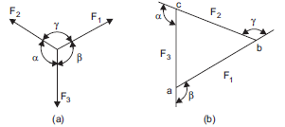
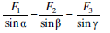
EQUILIBRIUM OF CONCURRENT FORCE SYSTEMS
In planar problems the resultant R of a system of forces is zero only when the following conditions are satisfied
ΣFx = 0
ΣFy = 0
If a body is in equilibrium under the action of only three concurrent forces, Lami’s theorem also may be used.
Lami’s theorem states : If a body is in equilibrium under the action of three forces, each force is proportional to the sine of the angle between the other two forces.
Thus, for the system of forces shown in Fig.

Slide 36
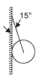
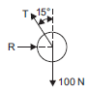
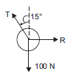
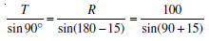
Example A sphere of weight 100 N is tied to a smooth wall by a string as shown in Fig. Find the tension T in the string and reaction R of the wall.
Solution: Free body diagram of the sphere is as shown in Fig. shows all the forces moving away from the centre of the ball. Applying Lami’s theorem to the system of forces
T = 103.53 N.
R = 26.79 N.

Slide 37
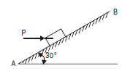
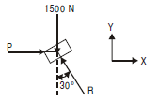
Example Determine the horizontal force P to be applied to a block of weight 1500 N to hold it in position on a smooth inclined plane AB which makes an angle of 30° with the horizontal.
Solution: The body is in equilibrium under the action of applied force P, self-weight 1500 N and normal reaction R from the plane. Since R, which is normal to the plane, makes 30° with the vertical (or 60° with the horizontal),
ΣFy = 0, gives
R cos 30°– 1500 = 0
R = 1732.06 N.
ΣFx = 0, gives
P – R sin 30° = 0
P = R sin 30°
P = 866.03 N.

Slide 38
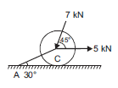
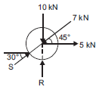
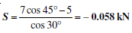
Example A roller of weight 10 kN rests on a smooth horizontal floor and is connected to the floor by the bar AC as shown in Fig. Determine the force in the bar AC and reaction from floor, if the roller is subjected to a horizontal force of 5 kN and an inclined force of 7 kN as shown in the figure.
Solution: A bar can develop a tensile force or a compressive force. Let the force developed be a compressive force S (push on the cylinder). Free Body Diagram of the cylinder is as shown in Fig.
Since there are more than three forces in the system, Lami’s equations cannot be applied.
Consider the components in horizontal and vertical directions.
ΣH = 0
S cos 30° + 5 – 7 cos 45° = 0

Slide 39
Since the value of S is negative the force exerted by the bar is not a push, but it is pull (tensile force in bar) of magnitude 0.058 kN.
ΣV = 0
R – 10 – 7 sin 45° + S sin 30° = 0
R = 10 + 7 sin 45° – S sin 30°
= 10 + 7 sin 45° – (– 0.058) sin 30°
R = 14.979 kN.

Slide 40
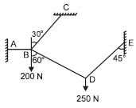
EQUILIBRIUM OF CONNECTED BODIES
When two or more bodies are in contact with one another, the system of forces appears as though it is a non-concurrent forces system. However, when each body is considered separately, in many situations it turns out to be a set of concurrent force system.
Example A system of connected flexible cables shown in Fig.is supporting two vertical forces 200 N and 250 N at points B and D. Determine the forces in various segments of the cable.

Slide 41
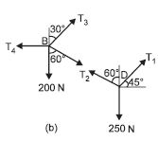


Solution: Free body diagrams of points B and D are shown in Fig. Let the forces in the members be as shown in the figure.
Applying Lami’s theorem to the system of forces at point D,
T1 = 224.14 N.
T2 = 183.01 N.
Consider the system of forces acting at B.
ΣV = 0
T3 cos 30° – 200 – T2 cos 60° = 0
T3 = 336.60 N.
ΣH = 0
T4 – T2 sin 60° – T3 sin 30° = 0
T4 = 183.01 × sin 60° + 336.60 sin 30°
T4 = 326.79 N.

Slide 42



Example A rope AB, 4.5 m long is connected at two points A and B at the same level 4 m apart. A load of 1500 N is suspended from a point C on the rope 1.5m from A as shown in Fig. What load connected at a point D on the rope, 1 m from B will be necessary to keep the position CD level ?
Solution: Drop perpendiculars CE and DF on AB.
Let CE = y and
AE = x
From ΔAEC, $x^{2}+y^{2}={1.\text{5}}^{2}$ = 2.25
Now, AB = 4 m
and AC + CD + BD = 4.5 m
i.e., CD = 4.5 – 1.5 – 1.0 = 2.0 m
∴ EF = 2.0 m
∴ BF = AB – (AE + EF)
= 4 – (x + 2.0) = 2 – x
From Δ BFD, ${BF}^{2}+{DF}^{2}=1^{2}$
(${2−x)}^{2}+y^{2}=$1

Slide 43





Applying Lami’s theorem to the system of forces acting at point C ,Fig. , we get
T1 = 3098.39 N
T2 = 2711.09 N
Applying Lami’s theorem to the system of forces at B Fig. , we get
T3 = 3993.28 N
and W = 2863.53 N.

Slide 44




Example. A wire rope is fixed at two points A and D as shown in Fig. Two weights 20 kN and 30 kN are attached to it at B and C, respectively. The weights rest with portions AB and BC inclined at angles 30° and 50° respectively, to the vertical as shown in figure. Find the tension in the wire in segments AB, BC and CD and also the inclination of the segments CD to vertical.
Solution: Applying Lami’s theorem for the system of forces at B Fig. , we get
T1 = 44.79 kN.
T2 = 29.24 kN.
Writing equations of equilibrium for the system of forces at C Fig., we get
T3 sin θ = T2 sin 50° = 22.4 kN.......1
T3 cos θ = 30 – T2 cos 50°……...2
= 11.20
From (1) and (2), tan θ = 1.998687
θ = 63.422°.
and T3 = 25.045 kN.

Slide 45



Example. Two smooth spheres each of radius 100 mm and weight 100 N, rest in a horizontal channel having vertical walls, the distance between which is 360 mm. Find the reactions at the points of contacts A, B, C and D shown in Fig.
Solution: Let O1 and O2 be the centres of the first and second spheres. Drop perpendicular O1P to the horizontal line through O2. Figures show free body diagram of the sphere
1 and 2, respectively. Since the surface of contact are smooth, reaction of B is in the radial direction, i.e., in the direction O1O2. Let it make angle a with the horizontal. Then,
Consider sphere No. 1.
ΣV = 0,
gives
RB × 0.6 = 100
RB = 166.67 N.
ΣH = 0,
gives
RA = RB × 0.8
∴ RA = 133.33 N.

Slide 46
Consider sphere No. 2
ΣV = 0,
gives
Rc = 100 + RB × 0.6
∴ Rc = 200 N.
ΣH = 0
RD = RB × 0.8
∴ RD = 133.33 N.

Slide 47




Trusses

Slide 48

Definition: A truss is a structure made up of slender members pin-connected at ends and is capable of taking loads at joints. They are used as roof trusses to support sloping roofs and as bridge trusses to support deck.
The trusses are also known as ‘pinjointed frames’.
A truss in which all the members lie in a single plane is called as a plane truss. Roof trusses and bridge trusses can be considered as plane trusses.
If all the members of a truss do not lie in a single plane, then it is called a space truss.
PERFECT, DEFICIENT AND REDUNDANT TRUSSES
A pinjointed truss which has got just sufficient number of members to resist the loads without undergoing appreciable deformation in shape is called a perfect truss.
Triangular truss is the simplest perfect truss and it has
three joints and three members

Slide 49

It may be observed that to increase one joint in a perfect truss, two more members are required. Hence the following expression may be written down as the relationship between number of joints j, and the number of members m, in a perfect truss.
m = 2j – 3
The only necessary and sufficient condition of a perfect truss is that it should retain its shape when load is applied at any joint in any direction.
A truss is said to be deficient if the number of members in it are less than that required for a perfect truss. Such trusses cannot retain their shape when loaded. A deficient truss is shown in Fig.

Slide 50

A truss is said to be redundant if the number of members in it are more than that required in a perfect truss. Such trusses cannot be analyzed by making use of the equations of equilibrium alone.

Slide 51
ASSUMPTIONS
The ends of the members are pin-connected (hinged);
(2) The loads act only at the joints;
(3) Self-weights of the members are negligible;
(4) Cross-section of the members is uniform.
If at all the cross-section varies, the centre of gravity of the section is assumed to be located along the same longitudinal line.
In most of the frames the loads act at the joints. Even if a load is not acting at a joint, it can be replaced by its reaction at the joint and a local bending effect on the member.

Slide 52



NATURE OF FORCES IN MEMBERS
The members of a truss are subjected to either tensile or compressive forces.
A typical truss ABCDE loaded at joint E is shown in Fig.
The member BC is subjected to compressive force C as shown in Fig. Effect of this force on the joint B (or C) is equal and opposite to the force C as shown in Fig.
The member AE is subjected to tensile force T. Its effect on the joints A and E are as shown in Fig. In the analysis of frame we mark the forces on the joints, instead of the forces in the members as shown in Fig. It may be noted that compressive force in a member is represented in a figure by two arrows going away from each other and a tensile force by two arrows coming towards each other.

Slide 53

METHODS OF ANALYSIS
The following three methods are available for the analysis of pin-connected frames:
Method of joints
Method of section
Graphical method.
The first two are analytical methods and they are dealt in this chapter.
METHOD OF JOINTS
Example 1. Find the forces in all the members of the truss shown in Fig. Tabulate the results.
Solution: Step 1: Determine the inclinations of all inclined members. In this case,
tan θ = 3 /3 = 1
∴ θ = 45°

Slide 54

Step 2: Look for a joint at which there are only two unknowns. If such a joint is not available, determine the reactions at the supports, and then at the supports these unknowns may reduce to only two.
Now at joints C, there are only two unknowns, i.e., forces in members CB and CD, say FCB and FCD.
Step 3: Now there are two equations of equilibrium for the forces meeting at the joint and two unknown forces. Hence, the unknown forces can be determined.
At joint C ΣV = 0 condition shows that the force FCB should act away from
the joint C so that its vertical component balances the vertical downward load at C.
FCB sin 45° = 40
∴ FCB = 40√2 kN
Now Σ H = 0 indicates that FCD should act towards C.
FCD – FCB cos 45° = 0
FCD = FCB cos 45° = 40√2 X 1/√2
= 40 kN

Slide 55

Step 4: On the diagram of the truss, mark arrows on the members near the joint analysed to indicate the forces on the joint. At the other end, mark the arrows in the reverse direction.
In the present case, near the joint C, the arrows are marked on the members CB and CD to indicate forces FCB and FCD directions as found in the analysis of joint C. Then reversed directions are marked in the members CB and CD near joints B and D, respectively.
Step 5: Look for the next joint where there are only two unknown forces and analyse that joint.
In this case, there are only two unknown forces at the joint D as shown in Fig.
ΣV = 0
FDB = 40 kN
Σ H = 0
FDE = 40 kN

Slide 56

Step 6: Repeat steps 4 and 5 till forces in all the members are found
In the present case, after marking the forces in the members DB and DE, we find that analysis of joint B can be taken up. Referring to Fig.
ΣV = 0, gives
FBE sin 45° – 40 – 40 2 × sin 45° = 0
∴ FBE = 80 2 kN
Σ H = 0
FBA – FBE cos 45° – 40 2 × cos 45° = 0
FBA = 80 √2 x 1\ √2 + 40 √2 x 1\√2
∴ FBA = 120 kN

Slide 57


The directions of these forces are marked on the diagram. Now the analysis is complete since the forces in all the members are determined.

Slide 58


Example 2. Determine the forces in all the members of the truss shown in Fig. and indicate the magnitude and nature of forces on the diagram of the truss. All inclined members are at 60° to horizontal and length of each member is 2 m.
Solution: Now, we cannot find a joint with only two unknown forces without finding reactions. Consider the equilibrium of the entire frame.
Σ MA = 0, gives
RD × 4 – 40 × 1 – 60 × 2 – 50 × 3 = 0
∴ RD = 77.5 kN
Σ H = 0, gives
∴ HA = 0
∴ Reaction at A is vertical only
ΣV = 0,
Gives RA + 77.5 = 40 + 60 + 50
∴ RA = 72.5 kN
Joint A: ΣV = 0,
Gives FAB sin 60° = RA = 72.5
FAB = 83.7158 kN (Comp.)
Σ H = 0,
Gives FAE – 83.7158 cos 60° = 0
FAE = 41.8579 kN (Tension)

Slide 59


Joint D: ΣV = 0, gives
FDC sin 60° = RD = 77.5
∴ FDC = 89.4893 kN (Comp.)
Σ H = 0, gives
FDE – 87.4893 cos 60° = 0
∴ FDE = 44.7446 kN (Tension)
Joint B: ΣV = 0, gives
FBE sin 60° – FAB sin 60° + 40 = 0
FBE =
37.5278 (Tension)
Σ H = 0, gives
FBC – FAB cos 60° – FBE cos 60° = 0
FBC = (83.7158 + 37.5274) × 0.5
FBC = 60.6218 kN (Comp.)

Slide 60


Joint C: ΣV = 0, gives
FCE sin 60° + 50 – FDC sin 60° = 0
FCE =
31.7543 kN (Tension)

Slide 61



Example Determine the forces in the members of truss shown in Fig.
Solution:
Σ Forces in horizontal direction = 0, gives,
HA = 20 kN
ΣMA = 0 →
– RE × 8 + 50 × 4 + 40 × 8 + 20 × 4 + 30 × 4 = 0
∴ RE = 90 kN
ΣVA = 0, gives
VA + RE = 30 + 50 + 40 + 30
∴ VA = 150 – RE = 150 – 90 = 60 kN
Joint A: ΣV = 0 → FAB = 60 kN (Comp.)
ΣH = 0 → FAF = 20 kN (Tensile)
Joint E:
ΣV = 0, gives, FED = 90 kN (Comp.)
ΣH = 0, gives, FEF = 0

Slide 62



Joint B: Noting that inclined member is at 45°,
ΣV = 0; gives,
– FBF sin 45° – 30 + 60 = 0
FBF = 42.43 kN [Tensile]
ΣH = 0, gives
– FBC + FBF cos 45° = 0
or FBC = 42.43 × cos 45° = 30 kN [Comp.]
Joint C: ΣV = 0, gives FCF = 50 kN [Comp.]
ΣH = 0, gives 30 – FCD = 0
or FCD = 30 kN [Comp.]
Joint D: Noting that DF is at 45° as shown in Fig.
ΣV = 0 →
– FDF cos 45° + 90 – 40 = 0
or FDF =
50
cos 45°
= 70.71 kN [Tensile]

Slide 63

Final result is shown in Fig.

Slide 64

Example 3.5. Analyse the truss shown in Fig.

Slide 65
METHOD OF SECTION
Under the following two conditions the method of section is preferred over the method of joints:
In a large truss in which forces in only few members are required;
(2) In the situation where the method of joints fails to start/proceed with analysis.
In the method of section, after determining the reactions, a section line is drawn passing through not more than three members in which forces are not known such that the frame is cut into two separate parts.
Each part should be in equilibrium under the action of loads, reactions and forces in the members that are cut by the section line.
Equilibrium of any one of these two parts is considered and the unknown forces in the members cut by the section line are determined.
In this method it is an essential condition that the section line should pass through not more than three members in which forces are not known and it should separate the frame into two parts.

Slide 66


Example. Determine the forces in the members FH, HG and GI in the truss shown in Fig. Each load is 10 kN and all triangles are equilateral with sides 4 m.
Solution: Due to symmetry,
RA = R0 =1/2 × 10 × 7 = 35 kN
Take section (A)–(A), which cuts the members FH, GH and GI and separates the truss into two parts.
Consider the equilibrium of left hand side part as shown in Fig. (Prefer part in which number of forces are less).

Slide 67
ΣMG = 0, gives
FFH × 4 sin 60° – 35 × 12 + 10 × 10 + 10 × 6 + 10 × 2 = 0
FFH = 69.2820 kN (Comp.)
ΣV = 0, gives
FGH sin 60° + 10 + 10 + 10 – 35 = 0
FGH = 5.7735 kN (Comp.)
Σ H = 0, gives
FGI – FFH – FGH cos 60° = 0
FGI = 69.2820 + 5.7735 cos 60°
= 72.1688 kN (Tension)

